Slide 1
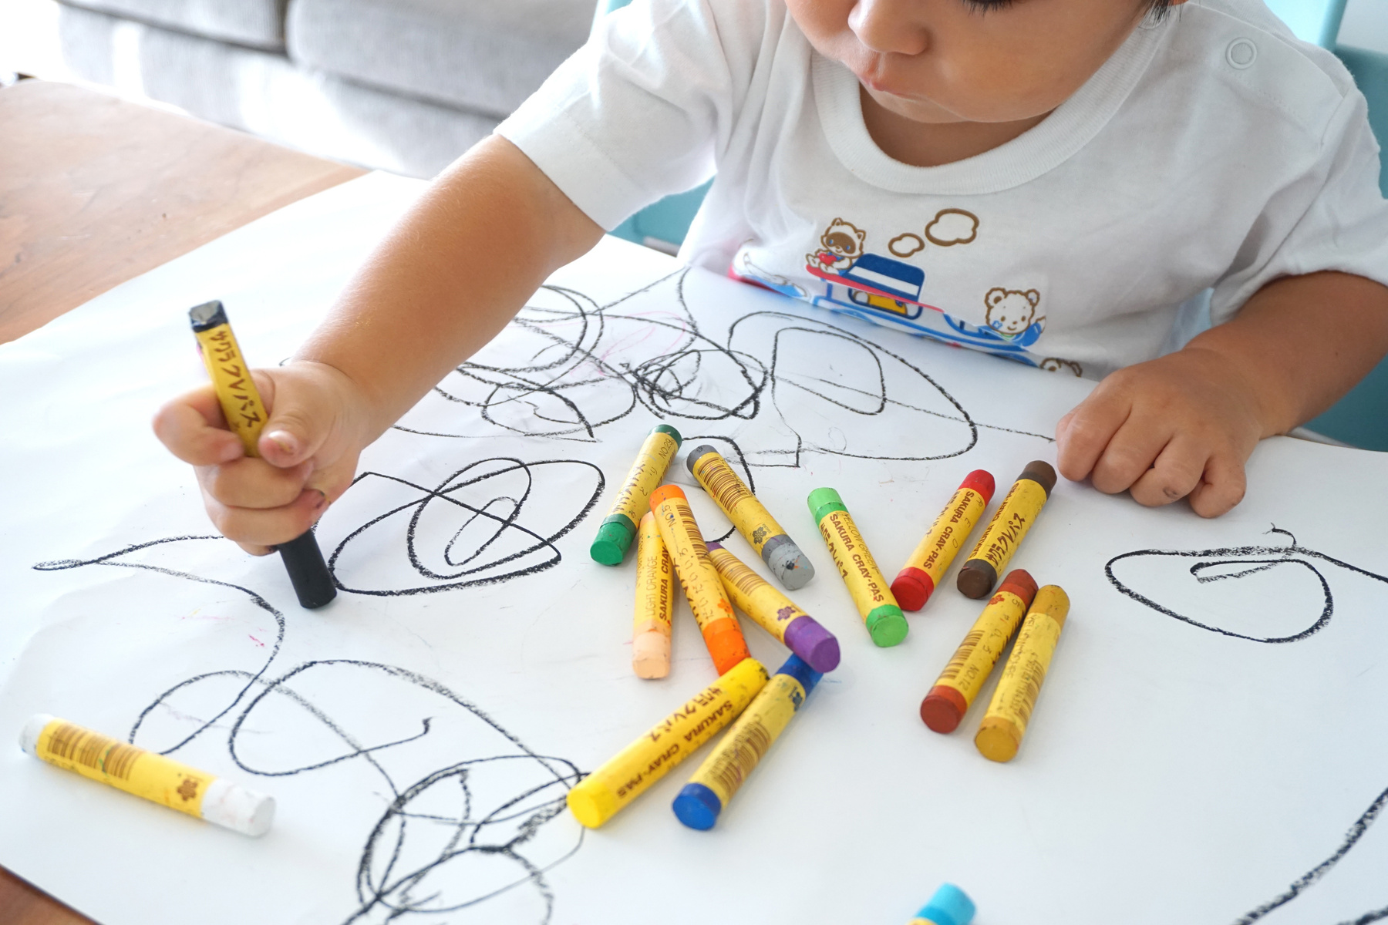
CoFounded by
European Union
INTIT
INTIT
INtegrated
Trauma Informed Therapy for Child Victims of Violence
INtegrated
Trauma Informed Therapy for Child Victims of Violence
TRAIN THE TRAINER HANDBOOK - SLIDES

Slide 2
Day 2
Trauma informed care and integrated systems
Day 2
Trauma informed care and integrated systems

Slide 3
INTRODUCTION
Today we are going to move from talking about what trauma is and how to recognize it in children to talking about what we – as professionals – can do to better work with the children that we come into contact with and help ensure that our actions do not cause further harm.
We will focus on 4 key issues:
1. Trauma informed care, looking at its development, what it means, and how you can implement it;
2. Fundamental rights of Children and Child-friendly justice;
3. Multi-agency cooperation and services integration;
4. Key skills for professionals;

Slide 4
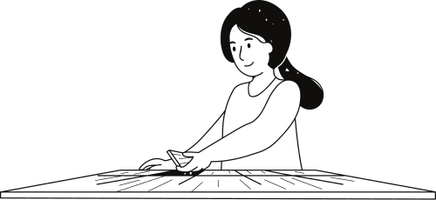
INTRODUCTION
- We will clarify the Core Principles of a Multiagency Trauma Informed Approach
- We will work together to understand how to put them into practice and
what standards should guide professional interventions with children who are victims of trauma.

Slide 5
Trauma informed care
• “Trauma-informed-care” approach has emerged as a response to better addressing trauma through service provision with early research and development financed by the based US Substance Abuse and Mental Health Services Administration (SAMHSA).
• A “plethora of theories, models, articles and training providers” has emerged constituting a challenge for practitioners to identify an appropriate approach for their respective setting and translating theory into practical implementation.
• This introduction to TIC highlights the core principles and underlying assumptions of a trauma informed approach as opposed to a trauma specific approach.
DAY 2 - Section 1

Slide 6
The Concept of “Trauma-Informed Care”
Definition
SAMHSA (as a funding body), developed its framework based on academic research, expertise by practitioners as well as survivors’ knowledge
SAMHSA defines a trauma-informed entity as follows:
“A program, organization, or system that is trauma-informed realizes the widespread impact of trauma and understands potential paths for recovery; recognizes the signs and symptoms of trauma in clients, families, staff, and others involved with the system; and responds by fully integrating knowledge about trauma into policies, procedures, and practices, and seeks to actively resist re- traumatization.”
DAY 2 - Section 2

Slide 7
Areas of Intervention and Key Assumptions
A trauma-informed approach is distinct from trauma-specific services. While it is inclusive of trauma-specific interventions such as assessment, treatment or recovery support, it also incorporates key trauma principles into the organizational culture.
A trauma-informed approach can be implemented in a wide range of services including but not limited to: behavioral and mental health, education, children and family welfare, criminal and juvenile justice, primary health care, homeless shelters, and the military.
DAY 2 - Section 3

Slide 8
Areas of Intervention and Key Assumptions
The TIC approach stems from the realization that public institutions and service systems themselves are often trauma-inducing causing “unintended” re-traumatization by treating a patient or client for behavioral issues (e.g. substance abuse, diagnosis of "conflict disorder" in children) in a vacuum without taking into account the impact of trauma.
Recognizing and understanding trauma could prevent misdiagnoses that are focused on treating symptoms alone while failing to address the underlying cause of a “mental injury”.
Children and youth are frequently labeled as “oppositional” and misdiagnosed with ADHD or a bipolar disorder. Adoption of a trauma informed approach reflects the recognition that many individuals experience trauma that in turn influences their behavior and may be exacerbated by an inappropriate response by a service or caregiver.
DAY 2 - Section 3

Slide 9
The four “R”s
The four “Rs” are fundamental to any organization aiming to become trauma informed
and reflect a cultural change within the organization as well as in the way it relates
to external individuals who use the services.
REALIZES All people within an organization or system have a basic realization of trauma and how it affects families, groups, organizations, communities and individuals. There should be an awareness that trauma should be systematically addressed in prevention, treatment and recovery settings.
RECOGNIZES All people within an organization or system recognize the signs of trauma.
RESPONDS The program, organization or system responds by applying the principles of a trauma-informed approach to all areas of functioning including staff, leadership, policies, manuals and organizational culture.
RESISTS A TIC approach seeks to resist re-traumatization of clients as well as staff.

Slide 10
The four “R”s
TIC can be viewed as a “universal design for serving trauma survivors” with the entire system being used as a vehicle for intervention
=> significant paradigm shift involving whole support systems that need to broaden their scope of intervention from asking “how can I fix you” to “what do you need to support your development and recovery?

Slide 11
GROUP ACTIVITY
Complete the following 'Professional Quality of Life Scale' test
and compare the results together.
https://www.macmh.org/wp-content/uploads/2016/05/Wkshp22_handout.pdf

Slide 12
Core principles of TIC
SAMHSA developed six core equally important principles for TIC requiring an organization-wide commitment for putting these principles into practice.
Safety
Trustworthiness and Transparency
Peer Support
Collaboration and Mutuality
Empowerment, Voice and Choice
Cultural, Historical and Gender Issues

Slide 13
Core principles of TIC
Safety: staff and the people they serve feel physically and psychologically safe.
Trustworthiness and Transparency: organizational operations are geared towards building trust amongst clients, family members and staff.
Peer Support: “Peers” or “trauma survivors” are considered key elements in fostering healing and recovery. In the case of children, peers could be family members who themselves have experienced trauma during childhood.
Collaboration and Mutuality: Everyone in an organization or a system has a role to play in a trauma-informed approach. Power differences between staff and clients and amongst staff are leveled as opposed to replicating a hierarchy of expert knowledge and client compliance.
Empowerment, Voice and Choice: Organizations believe in resilience and the ability of individuals and communities to heal and recover from trauma. Self-advocacy skills are promoted and staff members are considered facilitators of recovery rather than controllers of recovery.

Slide 14
Becoming Trauma-Informed
The TIC approach needs to be fully endorsed and reflected in all areas of operation:
Leadership: needs to demonstrate its commitment and define clear expectations
Staff training and workforce development: professional caregivers often suffer from high levels of stress, burnout, compassion fatigue, and vicarious trauma.
Involvement of trauma survivors, people receiving services, and family members:
in all aspects of the organization including program design, service delivery, quality assurance, staff training, cultural competence and evaluation.
- Power shift from a focus on professional “experts” to valuing and incorporating the experiences of those who can relate
-Restitution of dignity for service recipients
DAY 2 - Section 6

Slide 15
Becoming Trauma-Informed
Inter- disciplinary and cross sector collaboration between service providers and amongst
systems of care: The lack of inter-agency cooperation could lead to misdiagnosis, false medication, and re-traumatization.
-Cooperation needs to be endorsed by leadership.
-Staff and clients benefit from the added values of a common case analysis and from a sense of shared responsibility
Address the intersections of trauma with culture, history, race, gender, location, and language, acknowledge the compounding impact of structural inequity, and are responsive to the unique needs of diverse communities.
Partnering with youth and families: Intentionally partnering at the individual, agency, community & systems level with a goal of making healthier people who are making healthier communities.
DAY 2 - Section 6

Slide 16
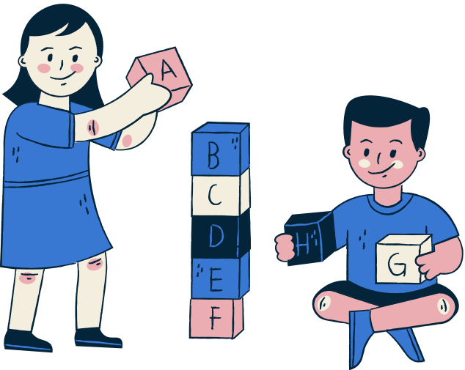
Becoming Trauma-Informed
Safety: The atmosphere and physical setting created within the school community is safe and welcoming. Interpersonal interactions promote a sense of emotional, social, and psychological security and well-being. Throughout the building, both children and adults, report feeling welcomed and invited by how the space is laid out and decorated, posted messages they read, imagery they see, and security measures in place.
CATEGORIES
Building security
Ensure physical security and accessibility are equally valued.
If physical security measures .
Increase, so do efforts to ensure accessibility. Your school is not willing to trade physical safety for a less welcoming, engaging, or inclusive atmosphere.

Slide 17
GROUP DISCUSSION
How can you adapt these principles to your working situation?

Slide 18
Ways Ahead: Benefits of Trauma – Informed Care
BENEFITS
Relatively low cost and high yield investment to address the needs of clients and patients who have experienced trauma.
By recognizing the implications of trauma, misdiagnoses are reduced and mislead medication can be avoided.
Participatory approach of involving trauma victims themselves has the potential to better tailor services towards clients’ needs and improve program retention rates.
Increase in inter-agency cooperation in TIC can enhance early identification of trauma while reducing re-traumatization through repeated questioning and interaction with multiple stakeholders.
Alleviation of emotional stress and vicarious traumatization of staff through training and through conveying the notion of shared responsibility between colleagues and systems.
DAY 2 - Section 7

Slide 19
GROUP DISCUSSION
Break the class intro small groups.
Ask each to discuss the extent to which their organization is trauma informed.
(10 minutes of break-out groups before reporting back)
What do they, as professionals, do that is trauma informed?
What can they do to become more trauma informed?
What, if anything, stands in the way of them becoming more trauma-informed?
Bring everyone back for reporting back and a class-level assessment of
the questions addressed.

Slide 20
Section 3:
Child friendly justice
Section 3:
Child friendly justice

Slide 21
New York Convention
The Convention on the Rights of the Child was approved by the United Nations General Assembly on 20 November 1989.
In particular, there are four general principles that cut across all the principles expressed by the Convention and that must guide the actions to promote and guarantee the rights contained in it
in favor of persons under the age of 18.
Art. 2: Principle of non-discrimination
Art. 3.1: Best interests of the child
Art. 6: Right to life, survival and development of the child
Art. 12: Principle of participation and respect for the opinion of the child

Slide 22
Child friendly justice
The notion of child friendly justice developed to address some of these concerns,
which are also addressed in the EU Victims’ Directive (EU Directive 2012/29/EU), in which child victims are recognized as special victims in need of additional protections.
The Council of Europe defines child friendly justice as being:
• accessible;
• age appropriate;
• speedy;
• diligent;
• adapted to and focused on the needs of the child;
• respecting the right to due process;
• respecting the right to participate in and to understand the proceedings;
• respecting the right to private and family life;
• respecting the right to integrity and dignity.
DAY 2 - Section 3

Slide 23
GROUP DISCUSSION
What do you believe can be done to make justice more child friendly in your country?
What laws or procedures would need to be changed?
What systemic changes would need to be made?
What could individual practitioners do?

Slide 24
Section 4:
Integrated Systems and the development of Barnahus
Section 4:
Integrated Systems and the development of Barnahus

Slide 25
What is an integrated system?
Integrated care systems can take many forms and sizes.
The integrated system itself refers to multiple services or organizations working cooperatively to provide an individual with what s/he needs.
Depending on the geographic scope, the integration can occur locally,
regionally or nationally.
The intent is to remove barriers between different services and organizations to ensure cooperation and coordination in the provision of care or service.
DAY 2 - Section 3

Slide 26
What is an integrated system?
In a more traditional system, each service or organization exists or operates separately.
As you can see, each circle – or organization - is completely separate from the other, making communication
and the coordination of actions difficult.
In an integrated system, the circles come into contact, allowing for the regular and easy flow of information.
This in turn allows for coordinated service delivery.
DAY 2 - Section 3

Slide 27
What is an integrated system?
Child victims of violence who become part of criminal proceedings are not just subject to standard care intended to increase their well-being and meet needs. They must also go through the criminal justice process while, potentially, not being allowed to access psychological or other services necessary to help them deal with their trauma.
An integrated system working with child victims therefore needs to bring together:
police, medical/forensic examiners, social services, mental health services, prosecutors, and potentially other actors.
As such it is especially important to ensure that their “time” within the criminal justice process is quick and avoids re-traumatization.
DAY 2 - Section 3

Slide 28
GROUP DISCUSSION
- To what extent is your organization integrated with others?
- How does this influence your ability to work and provide the best service to the children you work with?

Slide 29
Child Advocacy Centers and Barnahus
The need for an integrated criminal process for child victims of violence was first addressed
in the development of child advocacy centres in the United States, which were designed to decrease the risk of retraumatization for child victims of sexual assault.
The idea was to place all investigative and other services under one roof in order to simplify the evidence collection process in the interest of the child.
The model first came to Europe via Iceland which adopted the Barnahus model and has since spread throughout Europe.
The Barnahus, or children’s house, represents an all under one roof set of services designed to ensure a trauma informed child friendly approach to justice.
DAY 2 - Section 1

Slide 30
Barnahus Quality Standards
While each Barnahus operates somewhat differently and is, in some countries, limited by national legislation regulating the collection and giving of testimony, there are fundamental principles to which a Barnahus should adhere:
1: Key principles and cross-cutting activities
2: Multidisciplinary and interagency collaboration
3: Inclusive target group
4: Child friendly environment
5: Interagency case management
6: Forensic interview
7: Medical examination
8: Therapeutic services
9: Capacity building
10: Prevention: information sharing,
awareness raising and external competence building
11: awareness raising and external competence building

Slide 31
GROUP DISCUSSION
To what extent does the barnahus or integrated services system in your country meet the Barnahus quality standards?
What role does a trauma informed approach
play within the Barnahus?

Slide 32
Section 5: Key Skills
Section 5: Key Skills

Slide 33
Key Skills
Professionals who work with child victims of violence are called upon to utilize special skills in interacting with the children in order reduce the risk of re-victimization and retraumatization while also encouraging, when relevant, the child to talk about what has happened.
This training does not set out to help you develop those skills – you would need a separate training for that – but rather to make you aware of some of the material and tools that are available.
As a professional you can both turn to available tools such as Learning How to Ask and learn how to adopt key skills such as the creation of an emotional container when you encounter a dysregulated child and the importance of normalizing behaviours.
DAY 2 - Section 1

Slide 34
Promote Resilience
Resilience is a dynamic process of positive adaptation despite adversity.
For children, resilience pathways are rooted in:
- Having secure, stable and affective relationships that are continuous over time.
- Creating a context for growth through play, exploration and exposure to a variety of opportunities and activities to acquire skills, competencies and knowledge*.
*Citation: Center on the Developing Child at Harvard University.

Slide 35
What does resiliency look like in children?
Following a traumatic event a child’s pathway to resilience could include these elements:
Responding with minimal distress or effect on daily functioning.
Exhibiting a temporary dip in ability to cope followed by an early and effective return to a child’s usual level of functioning*.
*Citation: Resilience and Child Traumatic Stress. The National Child Traumatic Stress Network

Slide 36
Psychological safety
Emotional container
Safety
Connectedness

Slide 37
Emotional container
Stop, breathe, look and observe actively.
- Ignore negative behaviour, focus on feelings/affections;
- Try to name the mood and share it: "You seem to be very frustrated/your tension is very high“;
- Giving words to feelings: teaching words to describe one's own feelings (angry, sad, scared, unhappy).
REFLECT
Objective: to declare the validity of the child's experience.
Perception is reality;
- Validating does not mean accepting the behaviour;
- "I can understand that you are upset: you are in a new place and this can be really difficult".
VALIDATE
Normalising the response.
- Telling a child that what they are feeling is understandable
= reducing the shame;
- "I think anyone would be upset if they saw that no one is interested in what they are saying;
- "I know a lot of children are struggling to accept the rules of social distancing at the moment“.
NORMALISE
*Credits: “Resource Parents Curriculum, National Child Traumatic Stress Network”.

Slide 38
Is not about you!

Slide 39
BEHAVIOURS [USUALLY] HAVE A SENSE
What is the function of this behaviour?
What triggered it?
What are the emotions?
What are the thoughts?
How do you feel?

Slide 40
Safety
A concept under "safety" is “making it safe to talk” and explain how to handle a conversation if a child spills out their trauma (assuming that they are not in front of their therapist).

Slide 41
Connectedness
Under "Connection" it talk about the importance of establishing safe and predictable relationships with these children, so that the child can have a network of safe and predictable adults around him or her. we must also remember the great importance of connection between organizations.

Slide 42
Involving the caregiver
In order for the child to know how to regulate himself, I must know how to regulate so does the parent.
The caregiver is the main agent of change.
The caregiver is the person the child turns to and relies on when in and relies on in times of difficulty.
The relationship with the attachment figure influences the response to trauma.
Often, the caregiver's response to trauma influences the how the child perceives the trauma.
DAY 2 - Section 1

Slide 43
EXERCISE
Divide the class into groups of two/three.
Ask each person to think of something upsetting, that they then share with their partner in this exercise. The listener has the task of “containing” the other by recognizing and validating the others’ emotions and experience as normal given the circumstances.
All participants should have the opportunity to both be a listener and affected individual.
Bring the entire class back to discuss their feelings about the exercise.
How did they feel about the response they received?
How did it influence their emotional state?
What could/should have been done differently?

Slide 44
DAY 2

